Slide 1

‎PhD in Explainable Process Analytics
A Framework to Support the Data-Informed
Validation of Process Mining Inquiries

Slide 2
Motivation
Query result characterization
What have I selected and what as left out?
Query refinement assessment
What is the impact of
the refinement on the results?
Did my query yield the
expected results?
Did any two queries I ran produced the (same) desired result?
What queries have I ran so far?
Process Analysts
Did my new query help refining my previous one?
What subsets of the log
have I analyzed?
Analysis result summarization
Are there overlaps among the results I’ve obtained?
Query dependencies

Slide 3



Solution
Registry
Recording
Labelling
Retrieval
Visualization
Query Evaluator
Result Set
Complement
Result Set characterization
Set Level
Element Level
LogView

Slide 4
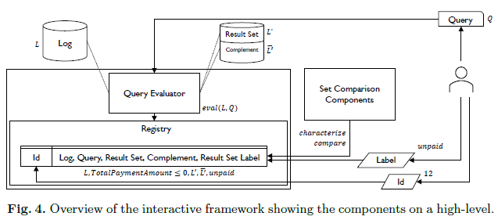
Usage scenario

Slide 5
Paper Highlights
Focus on the result set and complement.
Keeping a registry of query views.
Query dependency probability.
User defined properties.

